Slide 1
Lesson 3.2
Modern Web Application Programming

Slide 2
Learning Outcomes
Create Asynchronous Application
Use Async/Await
Use promise and async/await
Create fast and modern web application

Slide 3
Async and Await

Slide 4
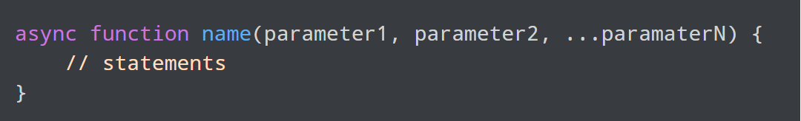
JavaScript async / await
In JavaScript, we can use the async and await keywords to make promises easier to write.
async makes a function return a Promise.
await makes a function wait for a Promise.
We use the async keyword with a function to represent that the function is an asynchronous function.
The async function returns a promise.

Slide 5
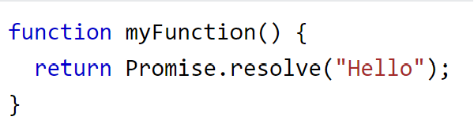
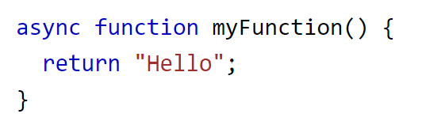
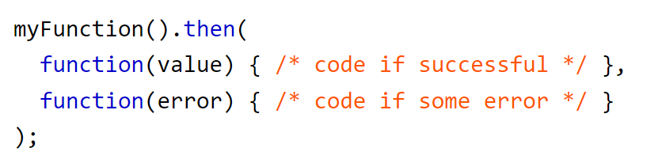
JavaScript async / await
These two functions do the same thing:
Use the function like this:

Slide 6

JavaScript async / await
The await keyword is used inside the async function to wait for the asynchronous operation.
The use of await pauses the async function until the promise returns a result (resolve or reject).
Note: await can ONLY be used inside async functions.
Syntax:
Example: https://codepen.io/michael-dorsey/pen/JjVYjZE

Slide 7
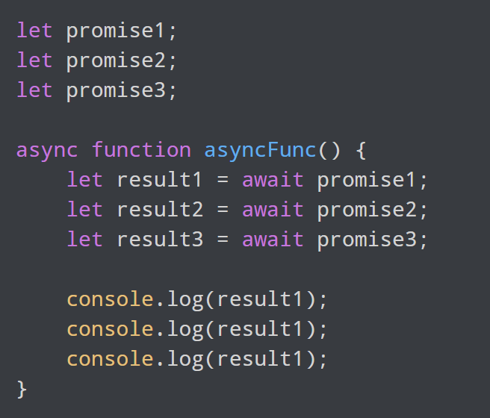
JavaScript async / await
Async and await allow asynchronous methods to be executed in a seemingly synchronous way.
This can be useful if there are multiple promises in a program, and you want to wait for each one to be completed before moving to the next one.

Slide 8
RESTful API

Slide 9
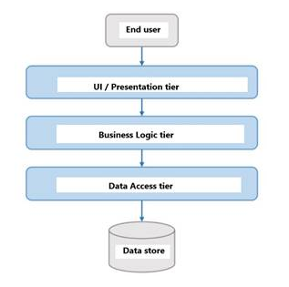
APIs
Remember when we discussed web application architectures?
In modern web applications, we join layers together with Application Programming Interfaces (APIs).
An API is how software developers agree to let one layer of a system talk to another layer of a system.
Even if they are written in different languages.
Even if they are running on different computers.
APIs provide a clean way to separate concerns. This means that code in each layer can focus on what it is good at, instead of trying to do everything.
Example: you can't build a user interface with SQL.

Slide 10
APIs
When building a web application, if everything is written in the same programming language then APIs are easy.
But what if you coded the user interface in C#, and you had to get a business object from a hosted online service that is written in JavaScript?
This is where APIs become very helpful, and therefore the standard way of designing modern web applications.
We connect different services using carefully controlled APIs.
If you want to use a service, you must call its API correctly.
If you call the API correctly, the underlying service will do something useful for you.

Slide 11
RESTful APIs
REST stands for representational state transfer.
A RESTful interface is a design pattern that represents business objects as resources that can undergo state changes through create, retrieve, update, and delete operations on the server using standard HTTP requests.
This means that when a client requests a resource using a REST API, the server transfers back the current state of the resource in a standardized representation.
CRUD:
Create
Retrieve
Update
Delete

Slide 12
RESTful APIs
Example: consider an application that lets you reserve study rooms.
Resources would be rooms, bookings, and users.
A RESTful API into this system would have interfaces to create bookings, retrieve bookings, update bookings, and delete bookings (CRUD).
From the client's point of view, it can send HTTP requests to change the state of a resource.
From the server's point of view, it is just managing a bunch of resources in a consistent state. The server does not know the state of the client, it just handles the requests.
Requests are 100% independent from each other.
The server does not "remember" anything about you from a previous request.
Each request is treated as an independent state transfer.

Slide 13
RESTful APIs
The RESTful API for our room booking application might include these example endpoints:
HTTP GET /bookings
Return a list of all bookings.
HTTP GET /bookings/user/123
Return a list of all bookings for user id #123.
HTTP POST /booking/room/9 [+ some data]
Create a booking for room #9.
HTTP PUT /booking/room/9 [+ some data]
Update a booking for room #9.
HTTP DELETE /booking/room/9
Delete all bookings for room #9

Slide 14
RESTful APIs
All RESTful API requests contain two pieces of information: HTTP verb, and an endpoint.
The HTTP verbs are GET, POST, PUT and DELETE.
Use GET to retrieve a resource.
Use POST to create a new resource.
Use PUT to edit or update an existing resource.
Use DELETE to delete a resource.
An endpoint is a URL which specifies the target resource. It is the location where the API interacts with the client.
Example of a request to the YouTube API for video data:
GET https://www.googleapis.com/youtube/v3/channels?part=contentDetails

Slide 15
RESTful APIs
The client code in our room booking application is responsible for calling the API endpoints correctly.
The server code in our room booking application is responsible for honoring each request.
RESTful APIs are useful because they provide a convenient abstraction for business objects and a way to interact with them using simple HTTP requests.

Slide 16
JSON
Process of making an API call:
A client browser sends a request with some data (e.g. HTTP GET /bookings/user/123)
The server looks at the data from the client and responds with some other data.
The client browser looks at the response and does something with it.
How does the client send data to a server?
How does the server send data back?
The answer is JavaScript Object Notation (JSON).
JSON is a way of representing JavaScript objects using text strings in a lightweight format that humans can easily read.

Slide 17
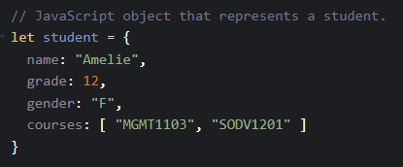
JSON
Remember that JavaScript objects can contain any data types and can be declared using object literal notation.
You can pass it to functions, change it, copy it, and send parts of it to the browser DOM for display.
But you can't send it in an API call to a server, because HTTP does not understand objects. HTTP is text-based.

Slide 18
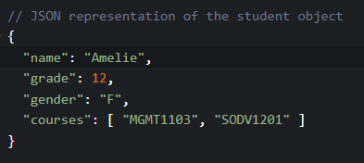
JSON
Solution: convert the JavaScript object to text using the JSON format.
JSON is not an object. JSON is a representation of an object in a string.
Main difference: property names in JSON have quotation marks (“”) around them.

Slide 19
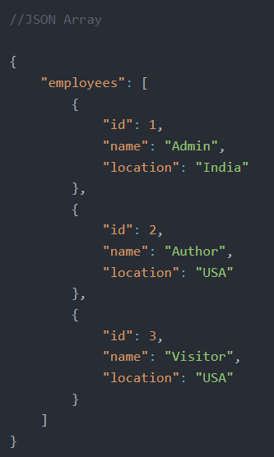
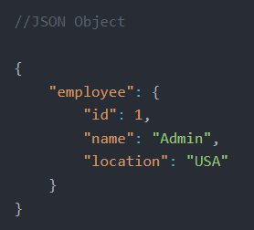
JSON
A valid JSON document can contain two structures:
An object surrounded by curly braces and containing multiple name/value pairs.
An array or ordered list of values surrounded by square brackets [ ].

Slide 20
JSON ⬅➔ JavaScript Object
How do you convert a JavaScript object to a JSON string?
let myString = JSON.stringify(myObject);
Converts a JavaScript object to a JSON-encoded string.
How do you convert a JSON string to a JavaScript object?
let myObject = JSON.parse(myString);
Converts a JSON-encoded string to a JavaScript object.
Example: https://codepen.io/michael-dorsey/pen/KKYdyRY

Slide 21
How to Use RESTful APIs
Documentation:
Web applications with publicly available APIs will have documentation available to developers with instructions on how to access and use the API.
If the API is built with REST principles, the documentation will indicate this.
API Key:
Many APIs require an API key to use.
An API key is a unique string of characters that an API provider gives to a developer to authorize access to their API.
API keys are often sent with client requests to identify the client to the server.
Keep your API key(s) private.
Example:
Publicly available API for providing currency exchange rates: https://www.exchangerate-api.com/
Standard documentation: https://www.exchangerate-api.com/docs/standard-requests

Slide 22
Fetch API

Slide 23

Fetch API
The Fetch API interface allows web browsers to make asynchronous HTTP requests to web servers.
The fetch() method is available in the global scope, and it instructs web browsers to send a request to a URL.
Syntax:
It requires one parameter which is the URL of the resource that you want to fetch
It returns a promise.

Slide 24
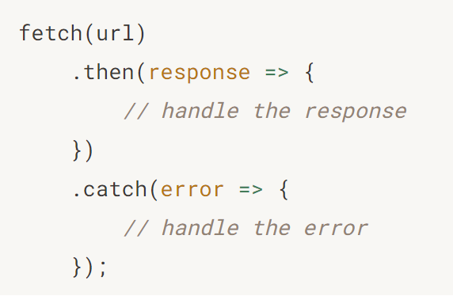
Fetch API
Because fetch() returns a promise, you can use the then() and catch() methods to handle it.

Slide 25
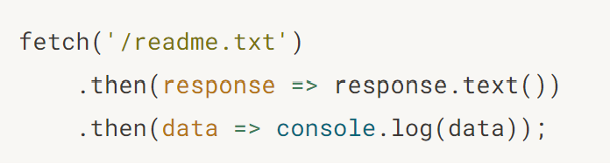
Fetch API
When a fetch() request is completed, the resource is available, and the promise will resolve into a Response object.
The Response object is the API wrapper for the fetched resource. The Response object has a few useful properties and methods to inspect the response.
Use the text() method to read the contents of the raw text.

Slide 26
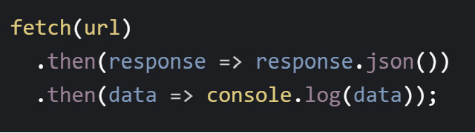
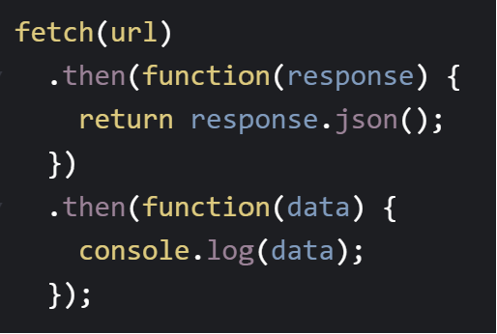
Fetch API
Use the json() method to convert from JSON to a JavaScript object.
(fat arrow version)
(regular function version)

Slide 27
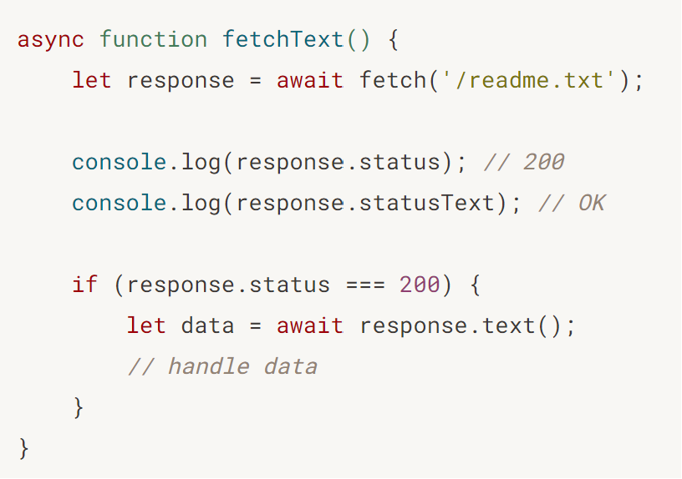
Fetch API
The Response object provides the status code and status text of the fetch response via the status and statusText properties.
response.status
response.statusText
When a request is successful, the status code is 200 and status text is ‘OK’.

Slide 28
Fetch API Options
The fetch() method contains an optional parameter called options.
fetch(url, options)
The options object contains any custom settings you want to apply to the request. The available settings are:
Method: GET (default), POST, PUT, DELETE.
Headers: any headers you want to include in your request. Useful for telling the server what type of data is incoming when doing a POST or PUT request.
Body: any data you want to include in your request. Useful for holding the data to be included in a POST or PUT request.

Slide 29
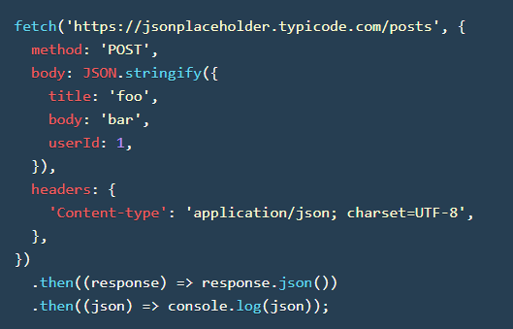
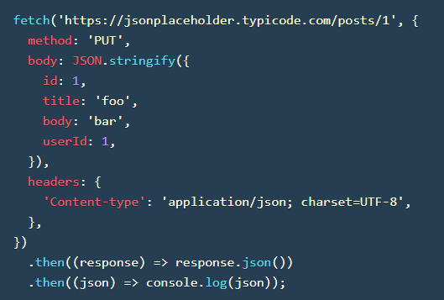
Fetch API Options

Slide 30

Fetch API Options

Slide 31
Fetch Demos
Fetch a text file (fetch_text.js).
Fetch a JSON file (fetch_json.js).
Fetch JSON data from an API: https://codepen.io/michael-dorsey/pen/rNbOajy.
Fetch JSON data from an API (get_all_posts.js) at this endpoint: https://jsonplaceholder.typicode.com/posts.
Post JSON data to an API (create_post.js).

Slide 32
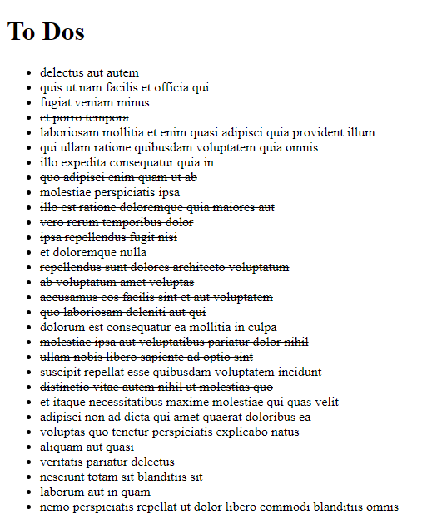
Practice Activity
Read the following API documentation: https://jsonplaceholder.typicode.com/
Fetch all the TODOs from the following endpoint: https://jsonplaceholder.typicode.com/todos
If the response status is OK, then build an HTML list of TODO item titles.
If the TODO item’s “completed” property is true, then add a strikethrough tag <s></s> to cross if off the list.
If the TODO item’s “completed” property is false, then print it regularly.
If the response status is not OK, then throw a new error.
Starter code is available at D2L > Class Resources > fetch-todos-starter.html

Slide 33
Assessments
Assignment 2
Worth 15% of your grade.
Covers Modules 1 - 5.
Due by August 20, 8:00am.

Slide 34
For next class
Read Lesson 4.1 and do Learning Activities 4.1.1, 4.1.2.
Read Lesson 4.2 and do Learning Activities 4.2.1, 4.2.2.
Assessments Reminder:
Assignment 2 due August 20, 8:00am.
Group Project due August 22, 11:59pm.
All assessment dates have been posted in D2L.
See the “Assignments Policy” for late submission procedures.

Slide 35
References
https://www.programiz.com/javascript/async-await
https://www.w3schools.com/js/js_async.asp
https://www.w3schools.com/js/js_api_intro.asp
https://blog.hubspot.com/website/what-is-rest-api
https://www.w3schools.in/restful-web-services/intro
https://restfulapi.net/introduction-to-json/
https://www.techtarget.com/searchapparchitecture/definition/RESTful-API
https://www.ibm.com/topics/rest-apis
https://www.javascripttutorial.net/javascript-fetch-api/
https://jsonplaceholder.typicode.com/

